Slide 1
MGMT298D
Science and Strategy of AI
Week 10
Product Pitches
UCLA Anderson School of Management
Auyon Siddiq

Slide 2
Agenda
2026 World Cup Companion Igor, Ryaas, Victor
10K BUFFETT Dan, Nabarun, Tin, Attin Can I Recycle This? Natalie, James, Krishna, Cemil FridgeAI Fran, Kiara, Derek, Kevin Astral Audio Meghana (on Zoom)
SnapCompare Shahab, Daniel, Malak, Alyssa Valet Shuo-Ru, Jenika, John
Team prizes!
Runner up: $100
Winner: $300
15 minute break
Live voting and results

Slide 3
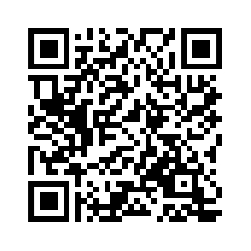
Voting
Vote now for 2 teams →

Slide 4
Results

Slide 5
Runner-up:
10-K BUFFET

Slide 6
Winner:
Valet

